Slide 1
6.3 De Moivre’s Theorem and Complex Roots in Polar Form
© Copyright all rights reserved to Homework depot: www.BCMath.ca

Slide 2
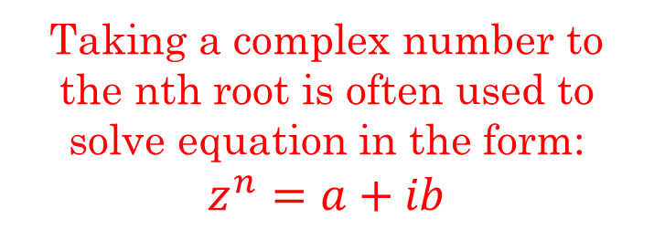
Writing complex Numbers in Euler Form
When a complex number is in “Euler” form, it is easier to multiply, taken to the n^{th} power or n^{th} root
Multiplying in Euler Form
Powers in Euler Form
Taking a complex number to the nth root is often used to solve equation in the form: $z^{n}=a+ib$
Roots in Euler Form
B/c of the Roots of Unity, you will have “n” roots equally spaced around an Argand Plane

Slide 3
Practice: Take each complex number to the n^{th} power

Slide 4
De Moivre’s Theorem:
De Moivre’s Thm can be used to take a complex number in Polar Form to the n^{th} power or n^{th} root
If “n” is a positive integer, this theorem can be easily proven using basic trig identtities
De Moivre’s thm can be used to separately find the real and imaginary components of a complex number

Slide 5
Ex: Given the complex number “z”, find the real and imaginary components of z^{n}
For what value(s) of “n” will “z” be only a Real Value?

Slide 6
First convert to Polar Form
Use De Moivres Formula

Slide 7
Use De Moivres Formula
Use De Moivres Formula

Slide 8
Converting Between $A+iB$ and Exponential form
If “a” and “b” can be used to create a “special triangle”, finding the angle in Euler form will be easy
Ex: Convert the following into Euler Form:
The complex number is pointing to the LEFT
The complex number is pointing DOWN
Q1, We have special triangle, 30, 60, 90

Slide 9
Using Euler’s Formula to Multiply Complex Numbers:

Slide 10
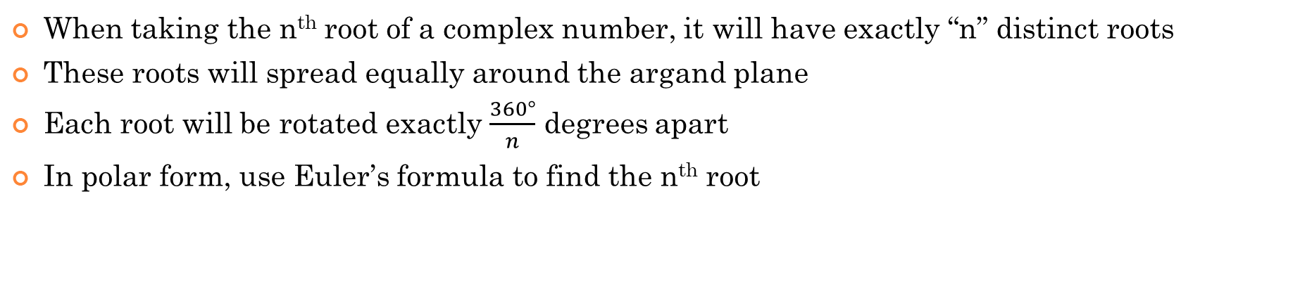
Finding Roots of Complex Numbers
When taking the n^{th} root of a complex number, it will have exactly “n” distinct roots
These roots will spread equally around the argand plane
Each root will be rotated exactly $\frac{360°}{n}$ degrees apart
In polar form, use Euler’s formula to find the n^{th} root

Slide 11
Ex: Find all fifth roots of 4 – 4i
First convert to Polar Form
Then find the general form:
Using DeMoivre’s theorem, we let $n=\frac{1}{5}$
Since we are taking the 5th root, there will be 5 distinct roots, where k = 0,1,2,3, and 4

Slide 12
These are the 5 distinct roots of
The five “fifth roots” of “z” will be
equally spaced out by 72° around the circle

Slide 13
Practice: Find the indicated roots in rectangular form using De Moivre’s theorem
Since it’s a cube root, there should be 3 complex roots
Each roots is spaced 120° apart

Slide 15
Since it’s a 6th root, there should be 6 complex roots
Each roots is spaced 60° apart

Slide 16
Ex: Solve for the roots of the following polynomials:

Slide 17
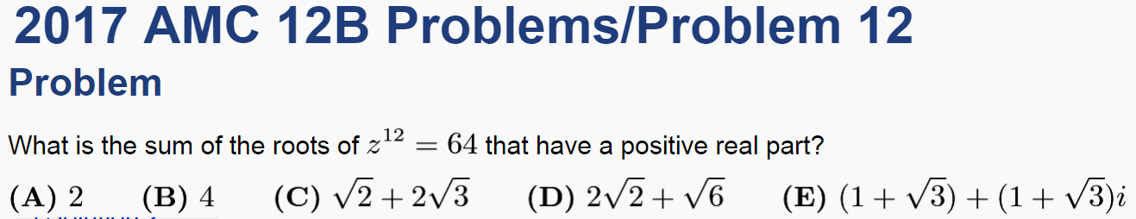
Since we are taking the 12th root of 64, we should have 12 distinct complex roots around the argand diagram
Which of these roots have real part that is positive?
Find the real value of the remaining roots

Slide 18
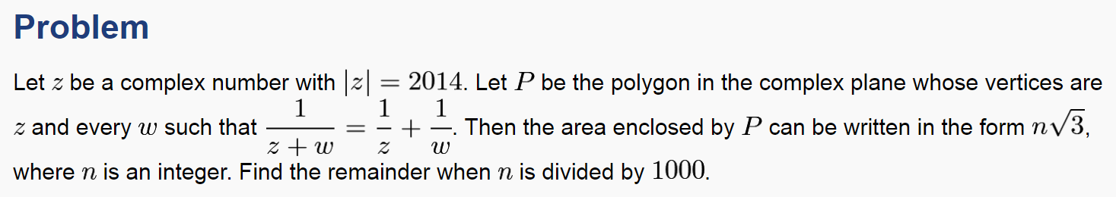

We are given an equation:
“z” is some complex number
Since there are 3 roots, they must be spaced 120° apart
All we need to do afterwards is find the area of this equilateral triangle
So, the polygon must be a equilateral triangle
In this equation, we have another variable “w”.
Since $\left|z\right|$=2014, the distance from the center to the vertex would be 2014
Two things we know about “w”
It’s a vertex of this polygon and the relationship it has with “z’
Suppose that z³ is also a complex number, then “w” is a cube root of z³
Using the roots of unity, we know that the cube root of z³ will have 3 roots

